Slide 1
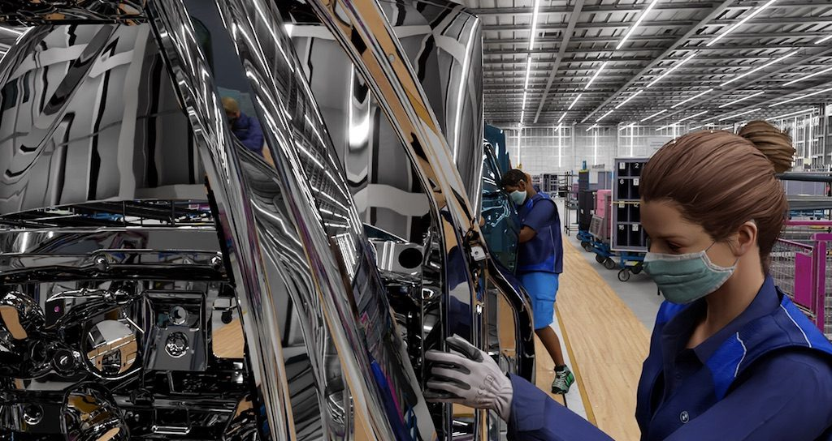
Synthetic Data Generation
for Machine Learning
Savelyev A.S. M107-22

Slide 2
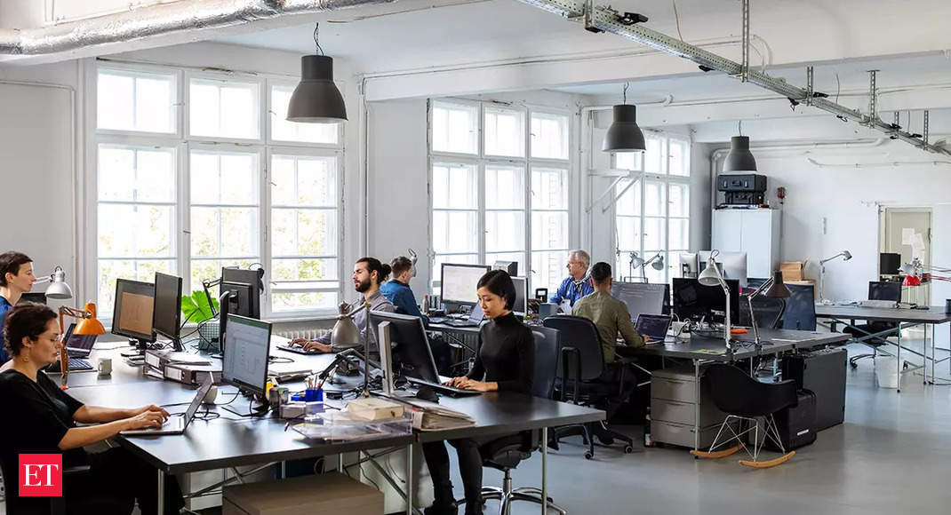


Abstract
Oh no...
We have no enough data...
Just generate it,
Bruh...

Slide 3

Abstract
Oh no...
We have no enough data...
Just generate it,
Bruh...

Slide 4

Abstract
We have no enough data...
Just generate it

Slide 5
Abstract
Oh no...
We have no enough data...
Just generate it,
Bruh...

Slide 6
Abstract
We have no enough data...
Just generate it

Slide 7
Abstract
Oh no...
We have no enough data...
Just generate it,
Bruh...

Slide 8
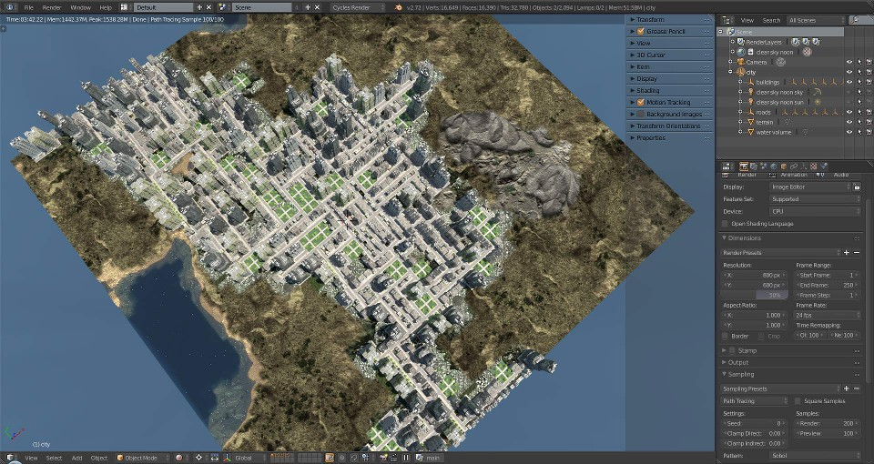
What is synthetic data
3D-Scene created
using City Generator

Slide 9
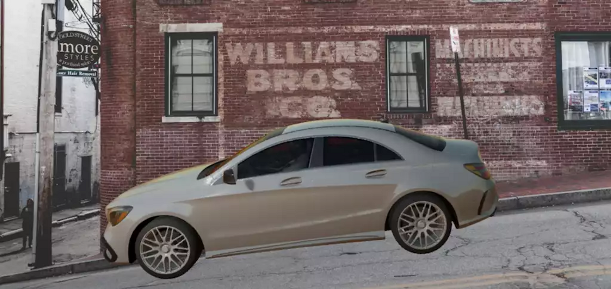
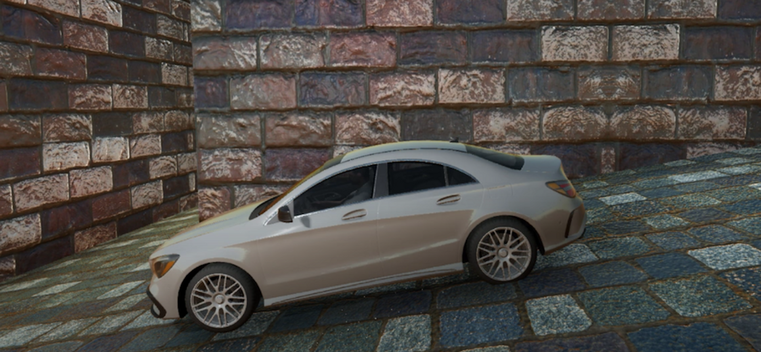
Types of synthetic data related to its composition
Partial Type
Background is real, car is not
Full type
Background and car is not real

Slide 10


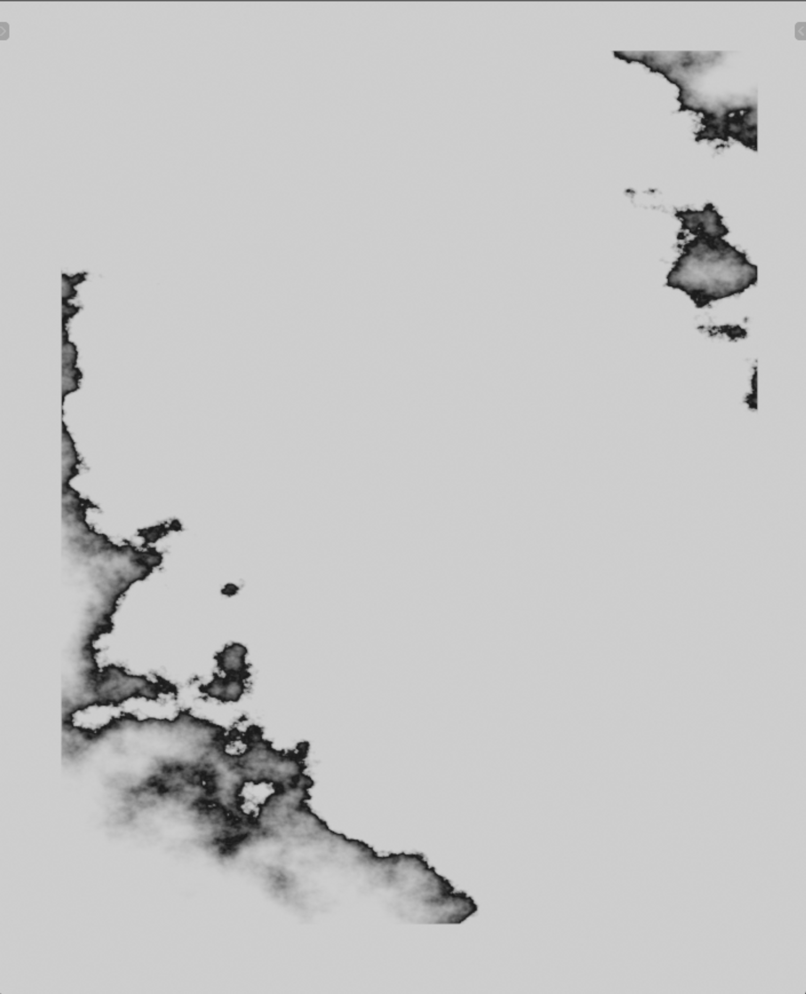

When and why synthetic data is used?
Workflow
Labeling like this
is so hard
Executor FaceCam
Unlabeled image
Labeled Alpha
Labeled Interlayer

Slide 11


When and why synthetic data is used?
Workflow
Labeling like this
is so easy
Generated image
Original image
Generated Alpha / Automatically labeled
Generated Interlayer / Automatically labeled
executor from prev slide be like:

Slide 12
When and why synthetic data is used?
Workflow
executor from
prev slide be like:
Labeling like this
is so easy
Generated image
Original image
Generated Alpha / Automatically labeled
Generated Interlayer / Automatically labeled

Slide 13
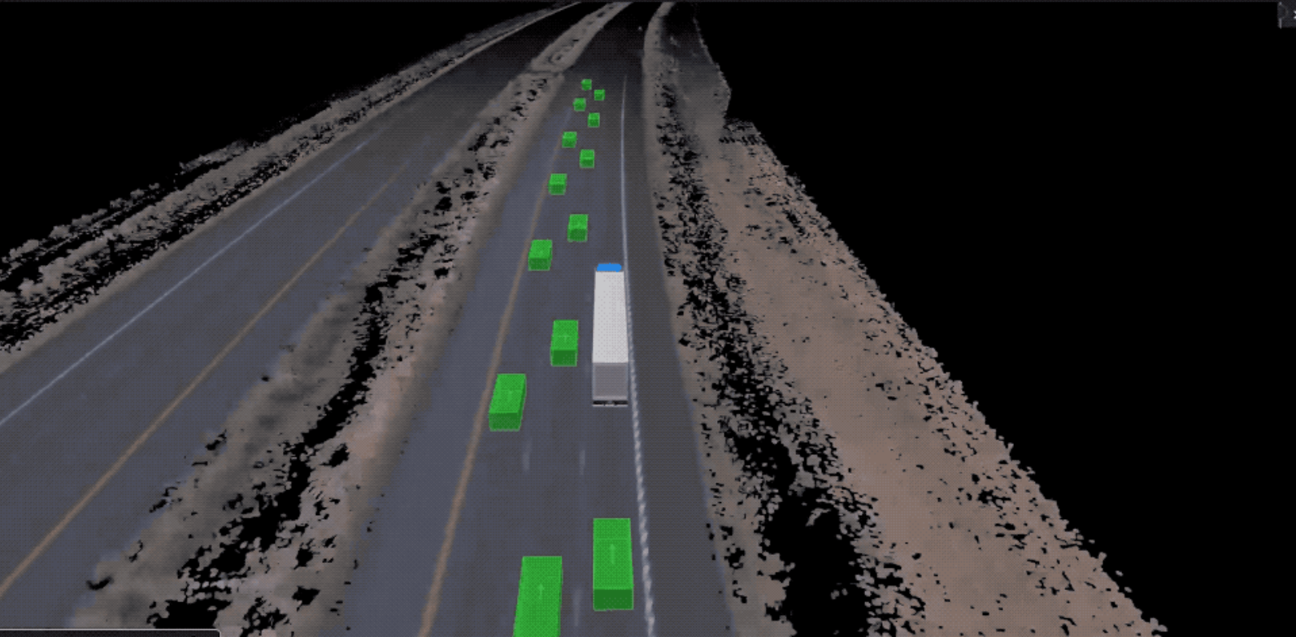
Cases of synthetic data application
Self-driving vehicles
by Waymo

Slide 14
Cases of synthetic data application
Virtual factory facility
by NVIDIA x BMW

Slide 15
Cases of synthetic data application
Fraud Prevention by American Express
The company used GANs to synthesize
fraudulent cases on which they did not
have enough data.

